Slide 1
The patient perspective on RLS – some burning questions
EURLSSG, December 10th 2021
Sören Berg, Sweden

Slide 2
This is EARLS
Since 2009, a coalition between national
RLS patient-organizations in Europe
Members today: Finland, France, Germany, Norway, Spain, Sweden, Netherlands and United Kingdom

Slide 3
EARLS objectives
To improve quality of life of people
living with RLS, throughout Europe
    More rapid and accurate diagnosis and treatment
    Intensified research
    Increased awareness and understanding
    Eliminated prejudice related to RLS
    Exchange between RLS patient advocacy groups
    Cooperate with scientific communities

Slide 4
National activities
Information to the public: Open meetings, Articles, Facebook-groups, Leaflets, Advertising, Webinars, Websites, Info through influencers, etc.
Contact with members: Magazines, Meetings for members, Individual counselling etc.
Professional contacts: Participating in professional education, Participating in scientific studies etc.

Slide 5
Common activities
  Exchange of knowledge and views
  Patient surveys 2012 and 2019
  Value of treatment study 2016 – 2017
  Coordinated activities connected to RLS-days
  International presentations and discussions
  Support for a European patient registry pilot

Slide 6
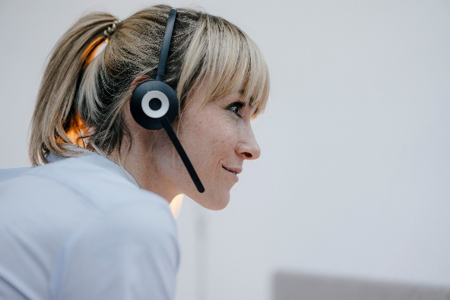


How we know what we know
(and what we do not know)
Individual counselling
What is the right treatment for me?
Magazines and facebook
Which alternative cures can help?
Discussions with members
What is in pipeline for the future?

Slide 7

Questions from individual counselling
Is there a shift in recommendations on first line treatment, away from dopamine agonists?
Are the official dose recommendations for pramipexol in line with up to date knowledge?
How much knowledge is there on long term effects of alfa2delta ligands, as gabapentin?
When is an opioid the best alternative? Efficiency and risks? How can I discuss with my doctor?
When can we have a clear and accepted European guideline?

Slide 8

Questions based on magazines, facebook and similar
What about heavy blankets, compression socks, vibrations, rocking etc?
What about non-prescription supplements like magnesium, selenium, omega 3 oils etc?
  Is there any evidence, pro or con?
  Possible interactions?
  Risks to be considered?
Could it be possible to give straight information on what is known and what is still unknown?

Slide 9

Questions from discussions among members
What new treatments are in pipeline? What could be the benefits? Which remaining questions are identified?
Are there any ideas on prevention?
How do industry, academia and payers cooperate? Possible improvement?
How can we, as patients, contribute?
  Participating more actively in studies? (For instance, by providing data in larger scale.)
  Suggesting research ideas?
  Increase funding? (Create opinion and political pressure? Crowd funding? )

Slide 10
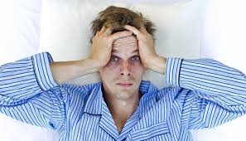
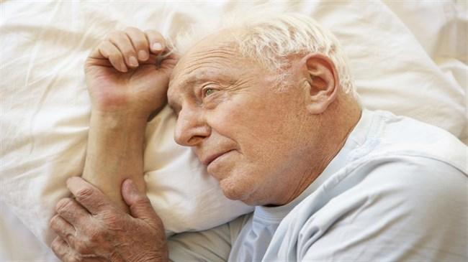
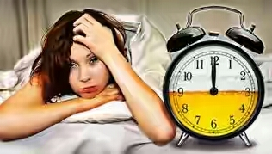
Conclusion
We know how it feels and affects us
You can understand why
With closer cooperation we can go further and faster

